Slide 1
Dava Week 3
Arhip Andrei-Emanoil
Cojocariu Vladut-Adrian
Diaconu Dan

Slide 2
Goals for second iteration
Use Case Diagram
Swagger, Database Connection
Implement base structure, CRUD operations

Slide 3
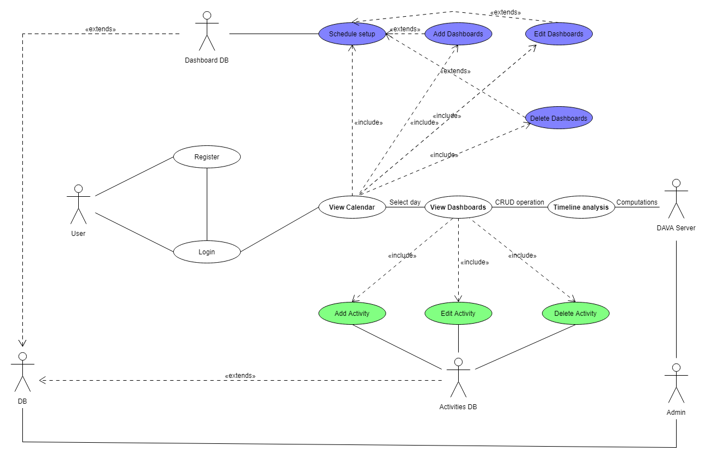
Use Case Diagram

Slide 4
Done
Use Case Diagram
Project prerequisite
Base structure
Work modules

Slide 5
Status
Layout
Angular Components
Units + Integration Tests

